Slide 1

DOCKER

Slide 2
What is Docker?
:- Docker is an open-source platform for building distributed software using “Containerization”, which packages applications together with their environments to make them more portable and easier to deploy.
Docker makes it easy to install and run software without needing to manually install and configure a ton of dependencies.

Slide 3
Docker is a set of Paas products that use OS-level virtualization to deliver software in packages called ‘Containers’.
Docker Engine :- The software that hosts container
Docker Image :- single file with all the dependencies and configuration to run a program the basis of docker container.
Docker Container :- in which application resides and executes isolated set of hardware resources

Slide 4
Docker File :- Is instructions to build Docker image.
FROM: for a base image, the command must be on top of the docker
RUN: To execute Command, it will create a layer in the image.
COPY: Copy files from the local system (docker VM) we need to provide a source, destination(We can't download file from the internet and any remote directory)
ADD: Similar to copy but, it provides a feature to download files from the internet, also weextract files at the docker image side.

Slide 5
WORKDIR: To set a working directory for a container.
CMD: Execute commands but during container creation
COMMANDS:-
Find an existing image in dockerhub
$ docker search IMAGE NAME
Download an image
$ docker pull IMAGE[:TAG]

Slide 6
Upload an image to a repository
$ docker push IMAGE
Delete an image
$ docker rmi IMAGE
Show a list of all images
$ docker images
builds image from dockerfile :- docker build –t image:tag :

Slide 7
CONTAINERS
Show a list of running containers
$ docker ps
Show a list of all containers
$ docker ps -a
Delete a container
$ docker rm CONTAINER

Slide 8
Info and Stats
● Login to a registry
$ docker login
● Logout of a registry
$ docker logout
● Show installed docker version
$ docker version
● Show the logs of a container:-$ docker logs CONTAINER

Slide 9
Docker Compose
● Docker Compose is a YAML file which contains details about the services, networks, and
volumes for setting up the Docker application.
● We can use Docker Compose to create separate containers, host them and get them to communicate with each other.
● Each container will expose a port for communicating with other containers.

Slide 10
Pre-installed on windows and Mac os
To install on Linux
pip install -u docker-compose.
Create docker compose file at any location on your system.
$ docker -compose.yml.
Check the validity of the using the command.
$ docker -compose config.

Slide 11
Run docker -compose.yml file by command
$ docker -compose up -d.
● Bring down the services using this command
$ docker -compose down.
● We can start all the services using single command
$ docker compose up
● We can stop all the services using single command
$ docker compose down

Slide 12
Docker Volume
Volumes are directories and files that exist on the host file system outside of the docker
container.
Docker containers are used to run applications in an isolated environment. By default, all
the changes inside the container is lost when the container stops.
If we want to keep the data between runs, Docker Volumes can help.
These volumes are used to persist data and share data between docker containers.

Slide 13
Create a volume :- $ docker volume create
Display detailed information on one or more volumes :- $ docker volume inspect
List Volumes :- $ docker volume ls
Remove all unused local volumes :- $ docker volume prune
Remove one or more volumes :- $ docker volume rm

Slide 14
Docker Network
Docker takes care of the networking aspects so that the containers can communicate with other containers and with the Docker Host.
Connect a container to a network
$ docker network connect
● Create a network
$ docker network create
● Disconnect a container from a network
$ docker network disconnect

Slide 15
Display detailed information on one or more networks
$ docker network inspect
● List networks
$ docker network ls
● Remove all unused networks
$ docker network prune
● Remove one or more networks
$ docker network rm

Slide 16

Designer helps you get your point across
PowerPoint Designer suggests professional designs for your presentation, based on the content in your slides.
Designer is a subscription-only feature. If you have an Office 365 subscription, the next slide shows you how it works in a new presentation.

Slide 17
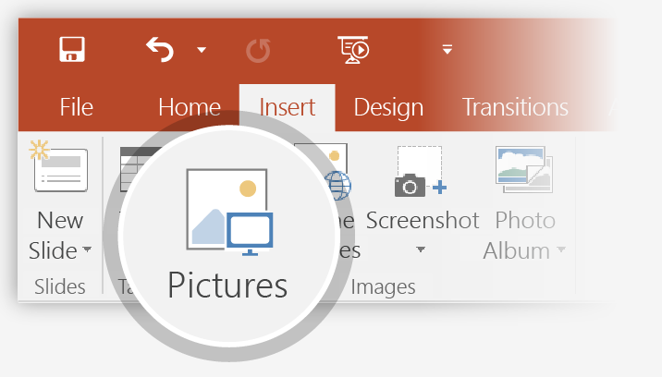
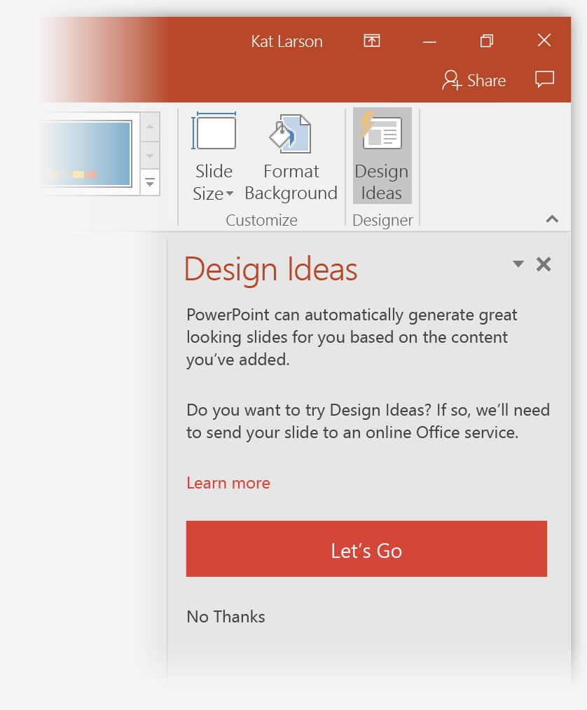
How to use PowerPoint Designer
How it works:
1
Start a new presentation by going to File > New > Blank Presentation.
2
On the very first slide, add a picture: Go to Insert > Pictures or Insert > Online Pictures and choose the picture. Hint: You need to be online when you add the picture.
3
When PowerPoint asks your permission to get design ideas, select Let's Go.
4
Choose a design you like from the Design Ideas task pane.

Slide 18
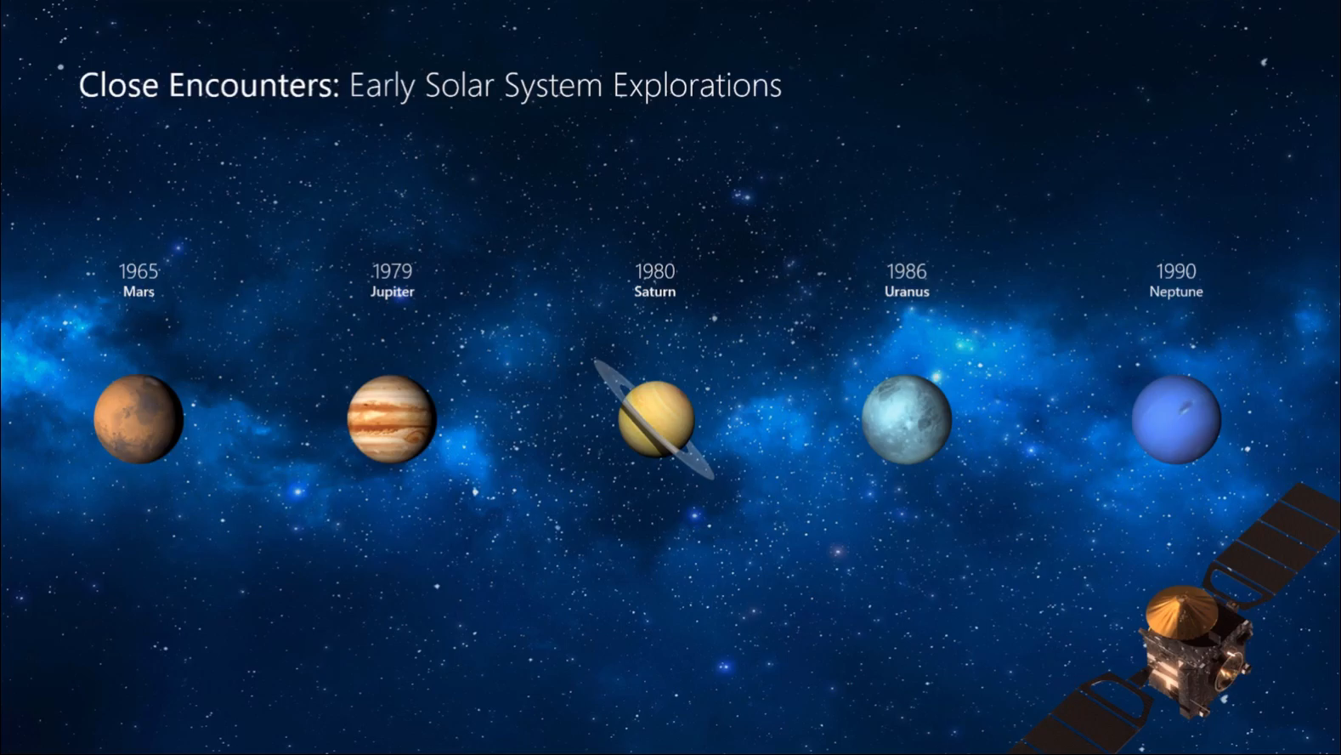
Morph
Morph makes smooth animations and object movements in your presentation. You use two similar slides to perform the animation, but it looks to your audience like the action happens on one slide.
Play the video on the right to see a quick example.
Morph is a subscription-only feature. If you have an Office 365 subscription, you can try it yourself with the steps on the next slide.

Slide 19
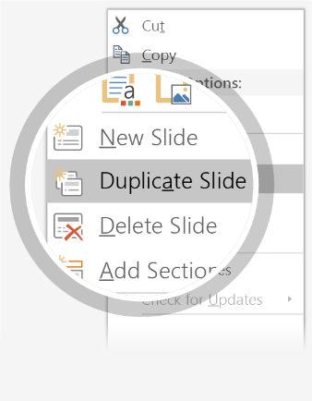
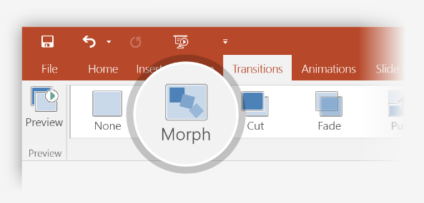

Setting up Morph
Try it yourself with these two simple “planets”:
1
Duplicate this slide: Right-click the slide thumbnail and select Duplicate Slide.
2
In the second of these two identical slides, change the shapes on the right in some way (move, resize, change color), then go to Transitions > Morph.
3
Return to the first of the two slides and press Slide Show button and then select Play to see your circle morph!
Hint: Effect Options gives you even more options for Morph.

Slide 20
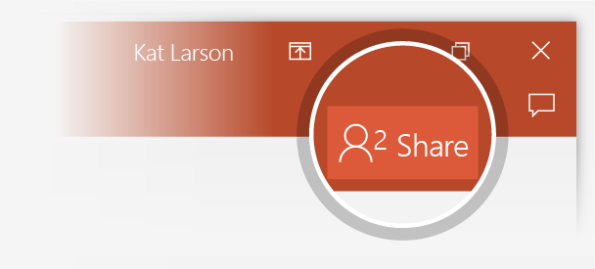
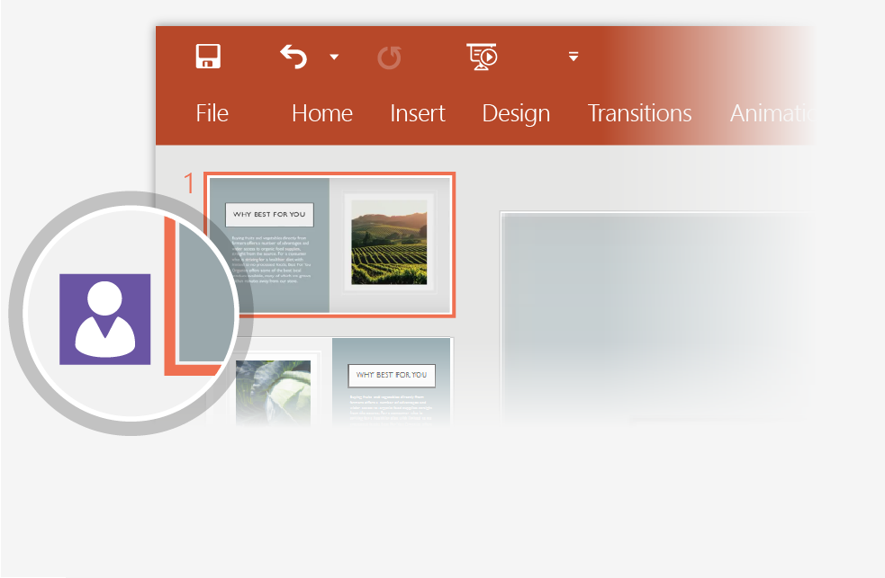
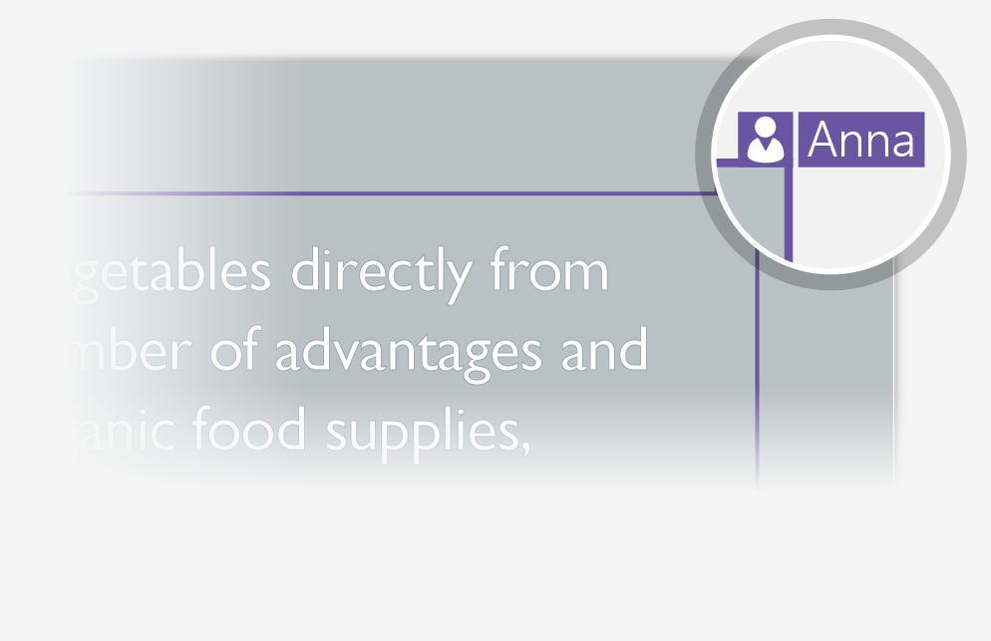
Working together in real time
When you share your presentation with others, you’ll see them working with you at the same time. How it works:
1
Select Share from above the ribbon, or by using short-key Alt-ZS, to invite people to work with you (You can save to the cloud at this point.)
2
When other people are in the presentation, a marker shows who is on which slide…
3
…and the part of the slide they're editing.

Slide 21


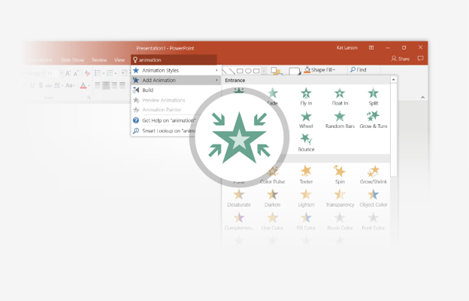
You’re an expert with Tell Me
The Tell Me box finds the right command when you need it, so you can save time and focus on your work. Try it:
SELECT ME
1
Select the Robot picture on the right.
2
Type animation in the Tell Me box, and then choose Add Animation.
3
Choose an animation effect, like Zoom, and watch what happens.

Slide 22
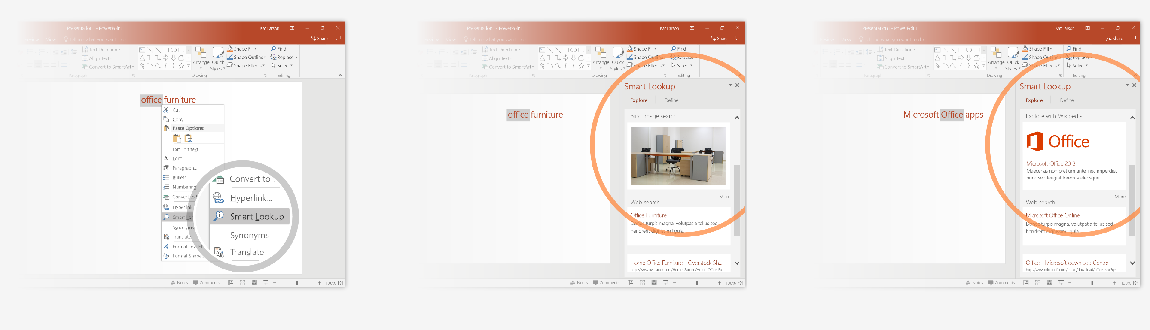
Explore without leaving your slides
Smart Lookup brings research directly in to PowerPoint. Try it:
1
Right-click in the word office in the following phrase: office furniture
2
Choose Smart Lookup, and notice that results are contextual for that phrase, not Microsoft Office apps.
3
Just for fun, try Smart Lookup again by right-clicking in the word Office in Step 2.

Slide 23

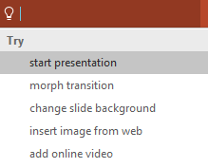

More questions about PowerPoint?
Select the Tell Me button and type what you want to know.
Visit the PowerPoint team blog
Go to free PowerPoint training
SELECT THE ARROW WHEN IN SLIDE SHOW MODE

